Slide 1
Measuring regressor and classifier errors
Quantifying model performance
Terence Parr
MSDS program University of San Francisco

Slide 2
Regressor losses/metrics

Slide 3
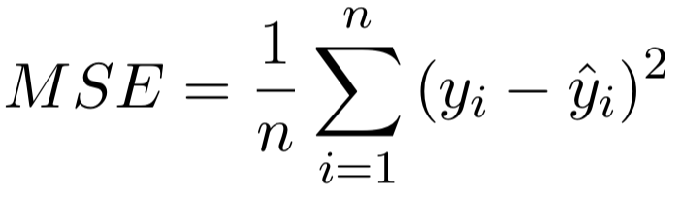
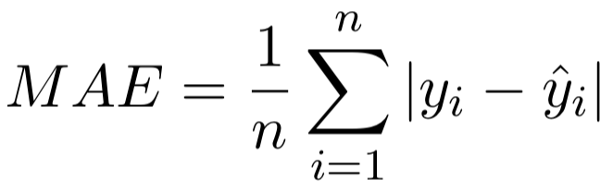
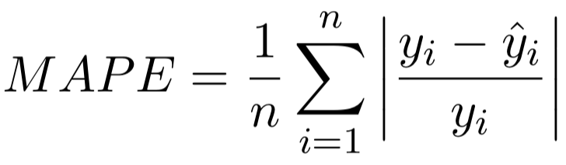
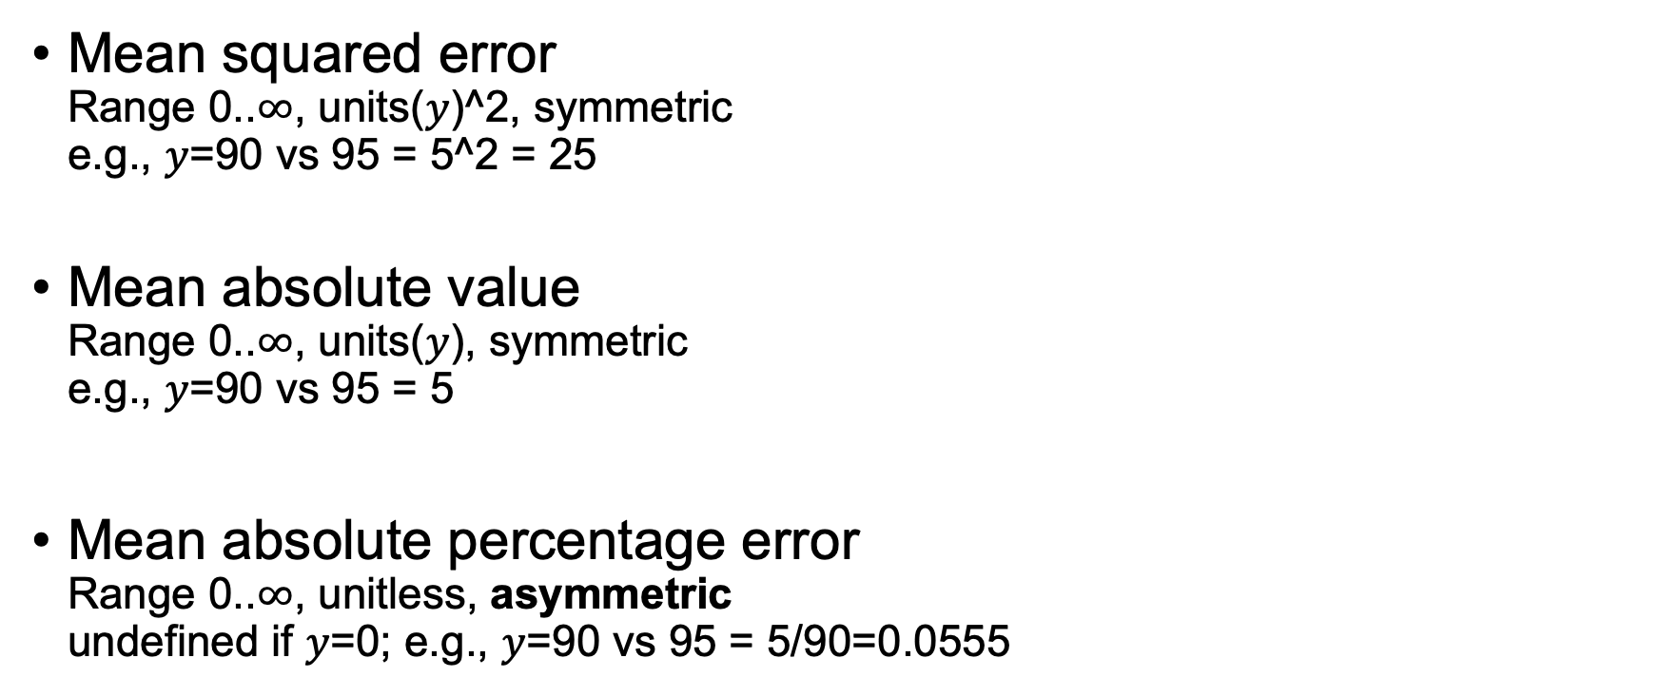
Common regressor loss funcs / metrics
Mean squared error Range 0..$∞$, units($y$)^2, symmetric e.g., $y$=90 vs 95 = 5^2 = 25
Mean absolute value Range 0..$∞$, units($y$), symmetric e.g., $y$=90 vs 95 = 5
Mean absolute percentage error Range 0..$∞$, unitless, asymmetric undefined if $y$=0; e.g., $y$=90 vs 95 = 5/90=0.0555
(For moment, think of symmetry as metric($y$, $\hat{y}$)=metric($\hat{y}$, $y$))

Slide 4
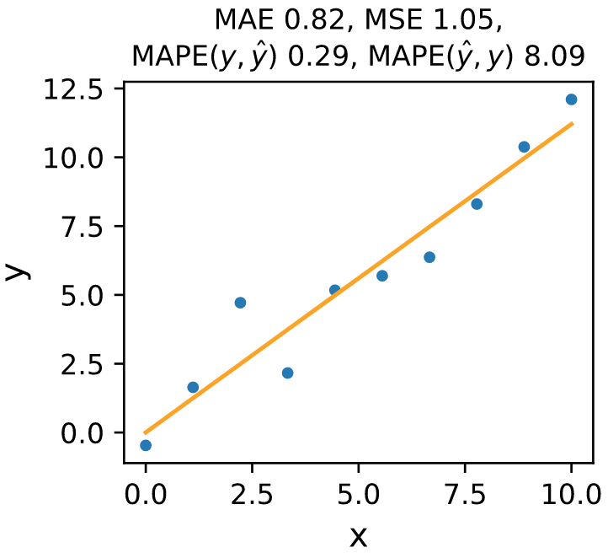
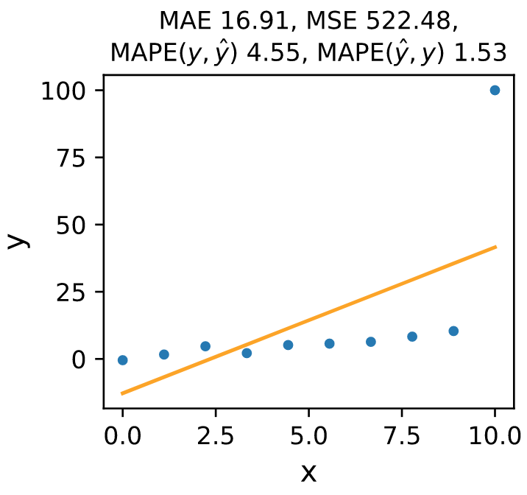
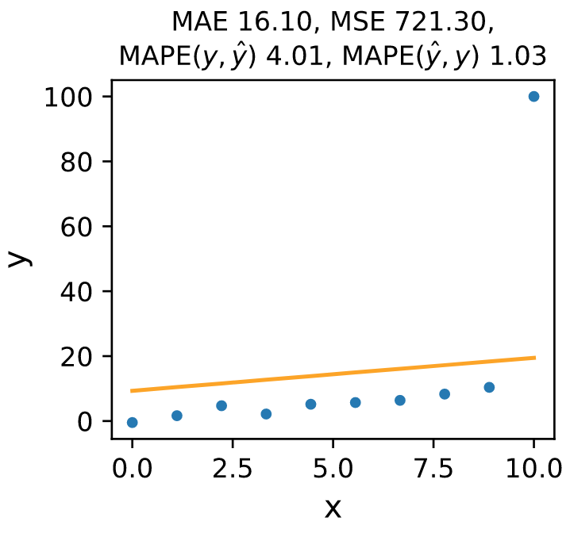
MAE, MSE, MAPE example
MSE incorrectly makes last model look horrible and worse than 2nd model due to outlier.
MAE isn’t perfect either as it thinks 2nd and 3rd models are about the same.
Note MAPE asymmetry!

Slide 5
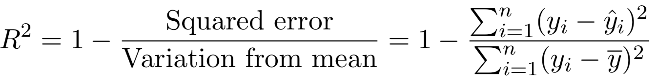
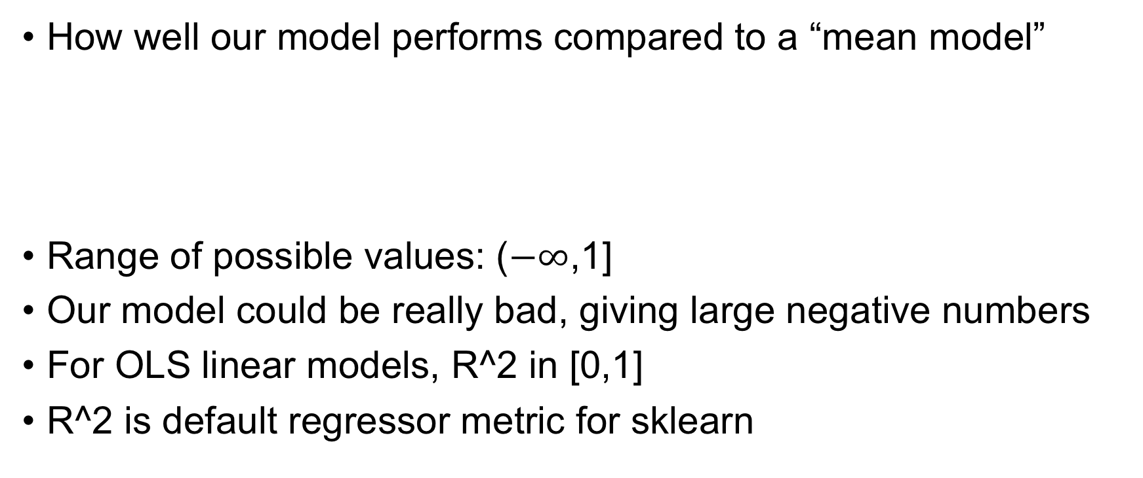
R^2
How well our model performs compared to a “mean model”
Range of possible values: ($−∞$,1]
Our model could be really bad, giving large negative numbers
For OLS linear models, R^2 in [0,1]
R^2 is default regressor metric for sklearn

Slide 6
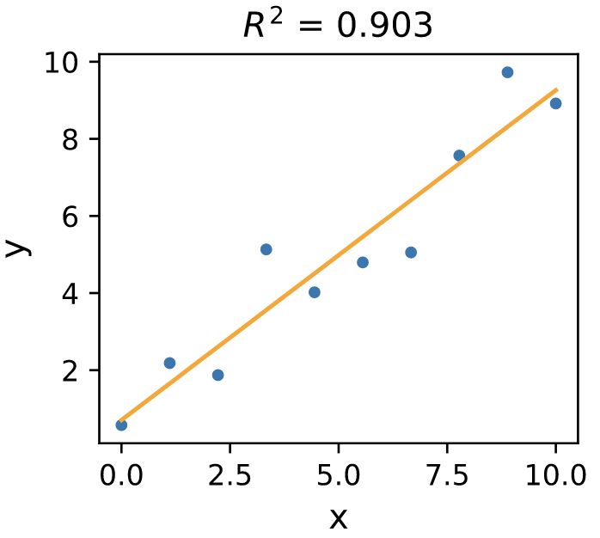
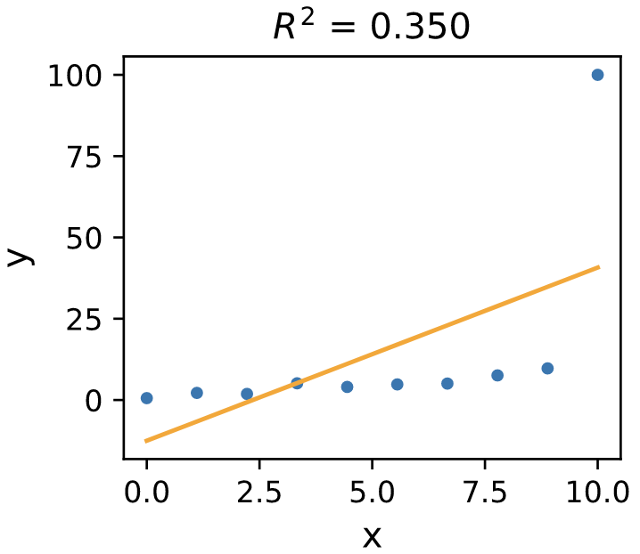
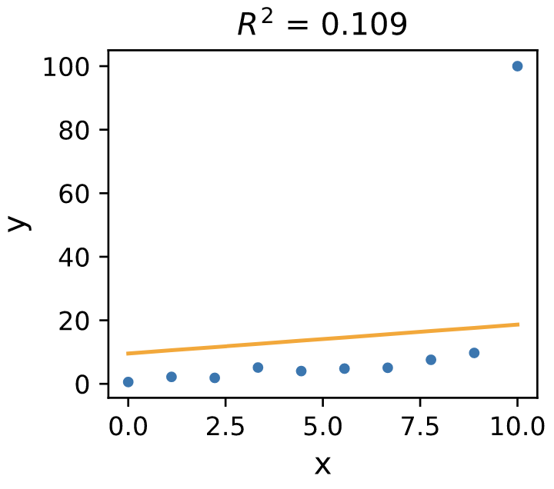
Low R^2 doesn’t always imply bad model
Not best metric; here are 3 graphs with good, bad, decent fits
Outliers can skew metrics that square deltas
The 3rd has lowest R^2 but it’s a way better model than 2nd

Slide 7
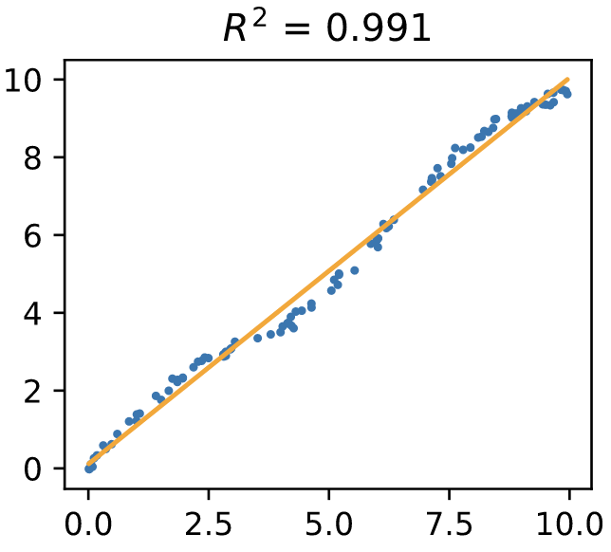
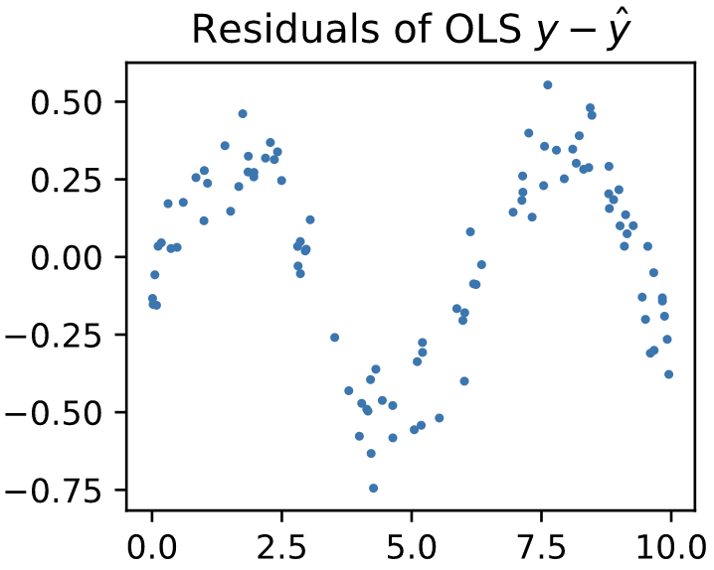
High R^2 doesn’t always imply good model
This linear model looks pretty good and has R^2 = 0.991
But check the residual plot! Model doesn’t capture nature of x,y
But, we want residuals to look like random noise!
See also https://statisticsbyjim.com/regression/interpret-r-squared-regression/

Slide 8
Which metric should we use?
That depends what we care about for business reasons
For prices, we usually care more about the percentage error than the absolute amount
MAE $500 for a $1,000 apartment is 0.5x or 1.5x off and a big deal but $500 error for a $1 million apartment is a trivial difference
For things like body temperature that will most likely all be within a small range, the mean absolute error (MAE) is a good and interpretable measure
The percentage error can be interpretable but there are problems with it: asymmetry (see next slide)
R^2, MSE and in general squaring errors yields metrics that are sensitive to big deltas from even a few test records

Slide 9
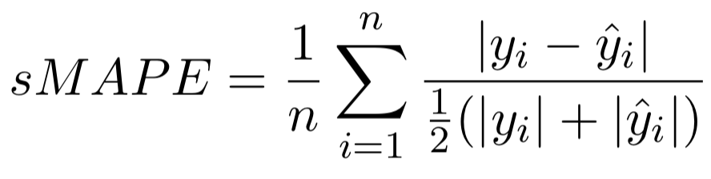
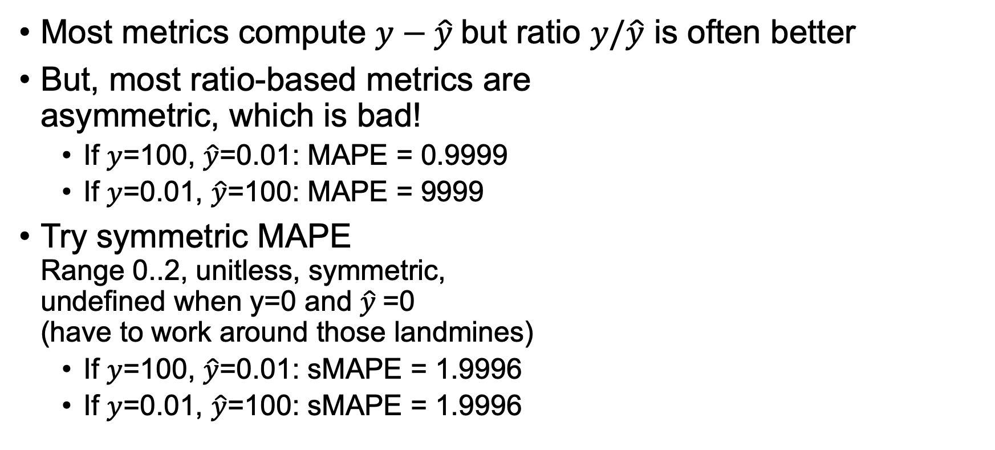
Symmetry in metrics
Most metrics compute $y−\hat{y}$but ratio $y/\hat{y}$ is often better
But, most ratio-based metrics are asymmetric, which is bad!
If $y$=100, $\hat{y}$=0.01: MAPE = 0.9999
If $y$=0.01, $\hat{y}$=100: MAPE = 9999
Try symmetric MAPE Range 0..2, unitless, symmetric, undefined when y=0 and $\hat{y}$=0 (have to work around those landmines)
If $y$=100, $\hat{y}$=0.01: sMAPE = 1.9996
If $y$=0.01, $\hat{y}$=100: sMAPE = 1.9996

Slide 10
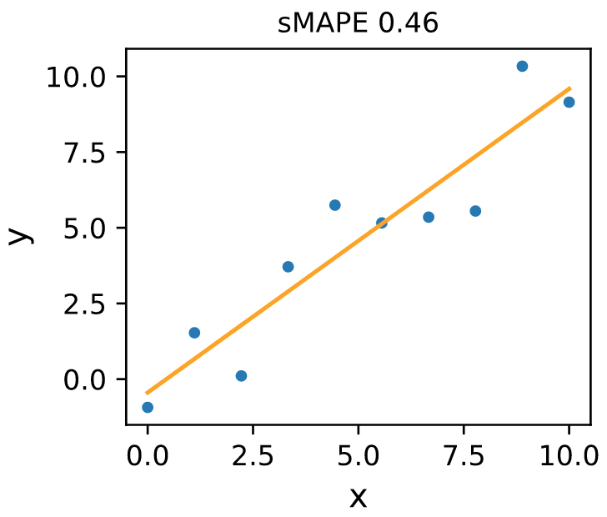
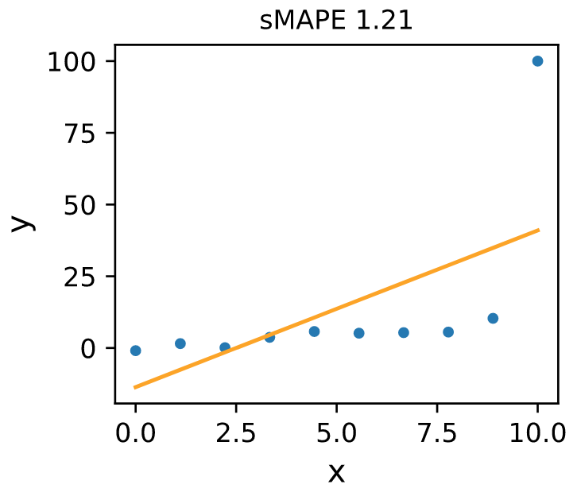
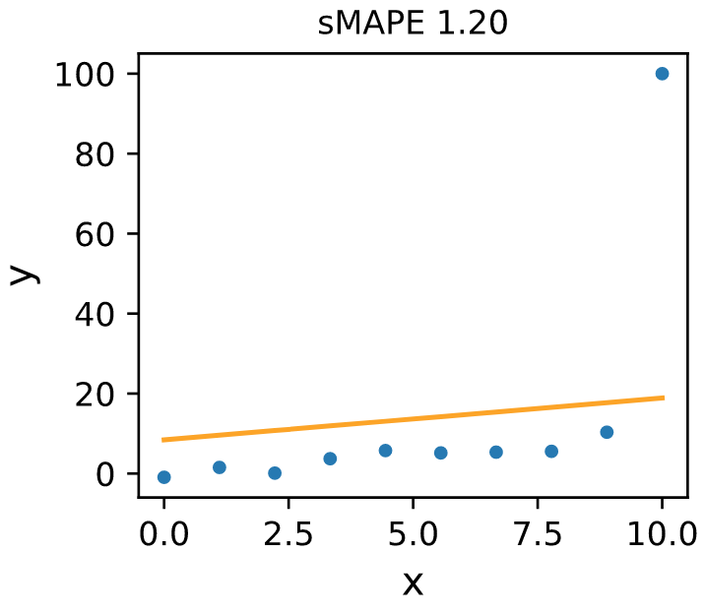
sMAPE in action

Slide 11
Classifier losses/metrics

Slide 12
Common classifier metrics (Ugh; much more complicated than for regressors)
TP = true positive, TN = true negative
FP = false positive, FN = false negative
Confusion matrix for binary classification to right, but can have larger confusion matrices in general
The matrices are clear but don’t give single metric
Accuracy = correct classification rate = (TN+TP)/n
Misclassification rate is 1 – accuracy
(breast cancer RF)
See also https://en.wikipedia.org/wiki/Evaluation_of_binary_classifiers

Slide 13
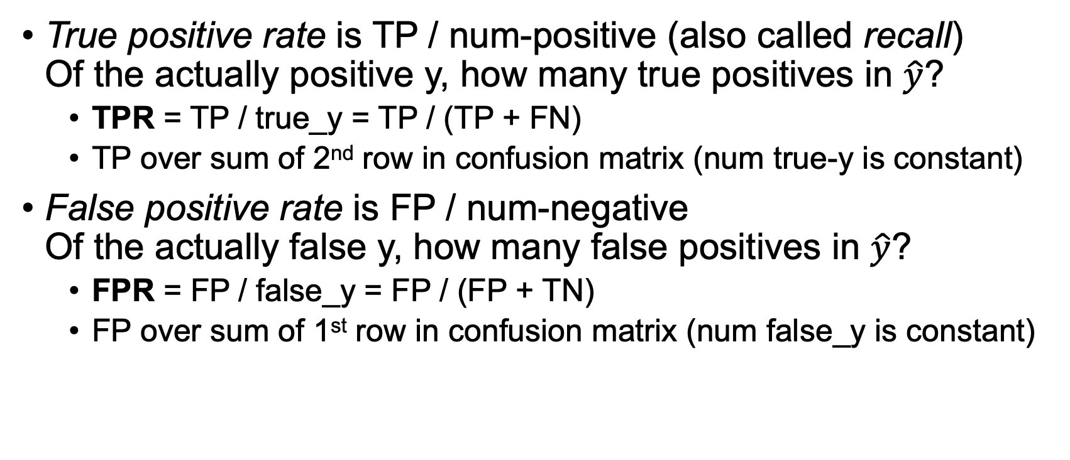
True/False positive/negative rates
True positive rate is TP / num-positive (also called recall) Of the actually positive y, how many true positives in $\hat{y}$?
TPR = TP / true_y = TP / (TP + FN)
TP over sum of 2nd row in confusion matrix (num true-y is constant)
False positive rate is FP / num-negative Of the actually false y, how many false positives in $\hat{y}$?
FPR = FP / false_y = FP / (FP + TN)
FP over sum of 1st row in confusion matrix (num false_y is constant)

Slide 14
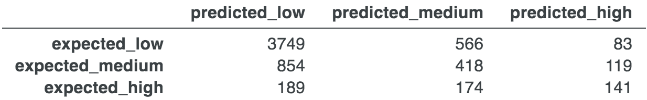
Multi-class confusion matrix
For C classes, we get C x C matrix
Optimally, it’s a diagonal matrix (correct classifications)
Example; interest in NYC apartments (lo/med/hi); matrix indicates model is good at predicting low interest apts but not others (sometimes overall error is high but very low for some records)
Should focus on features that are predictive of med/high to improve model

Slide 15
More classifier metrics (I like Precision/recall)
Precision/recall typically used in binary classification, such as spam or cancer
Precision = TP/(TP+FP) “of those predicted as positive, how many did we get right?”
Recall = TP/true_y “of the positive samples, how many did we find (predict as positive)?”
F1 is harmonic mean of precision and recall; F1 = 2*(P*R)/(P+R), which gives equal importance to precision and recall
See also https://en.wikipedia.org/wiki/Precision_and_recall

Slide 16
ROC and PR curves

Slide 17
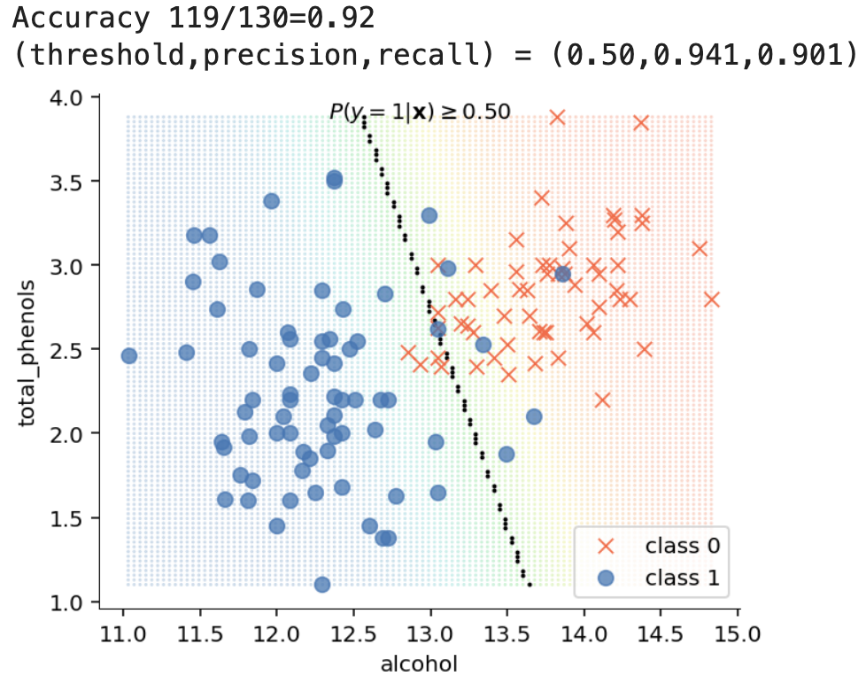
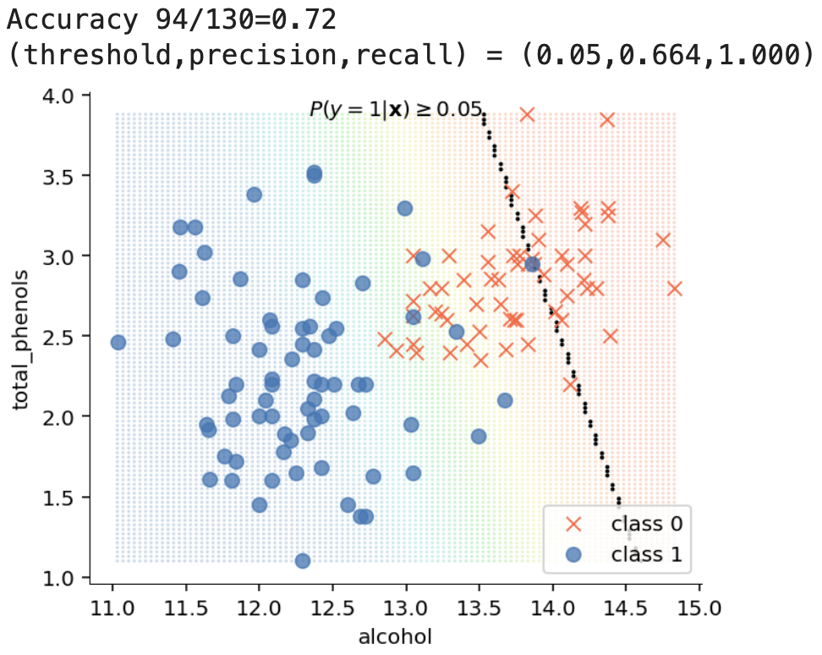
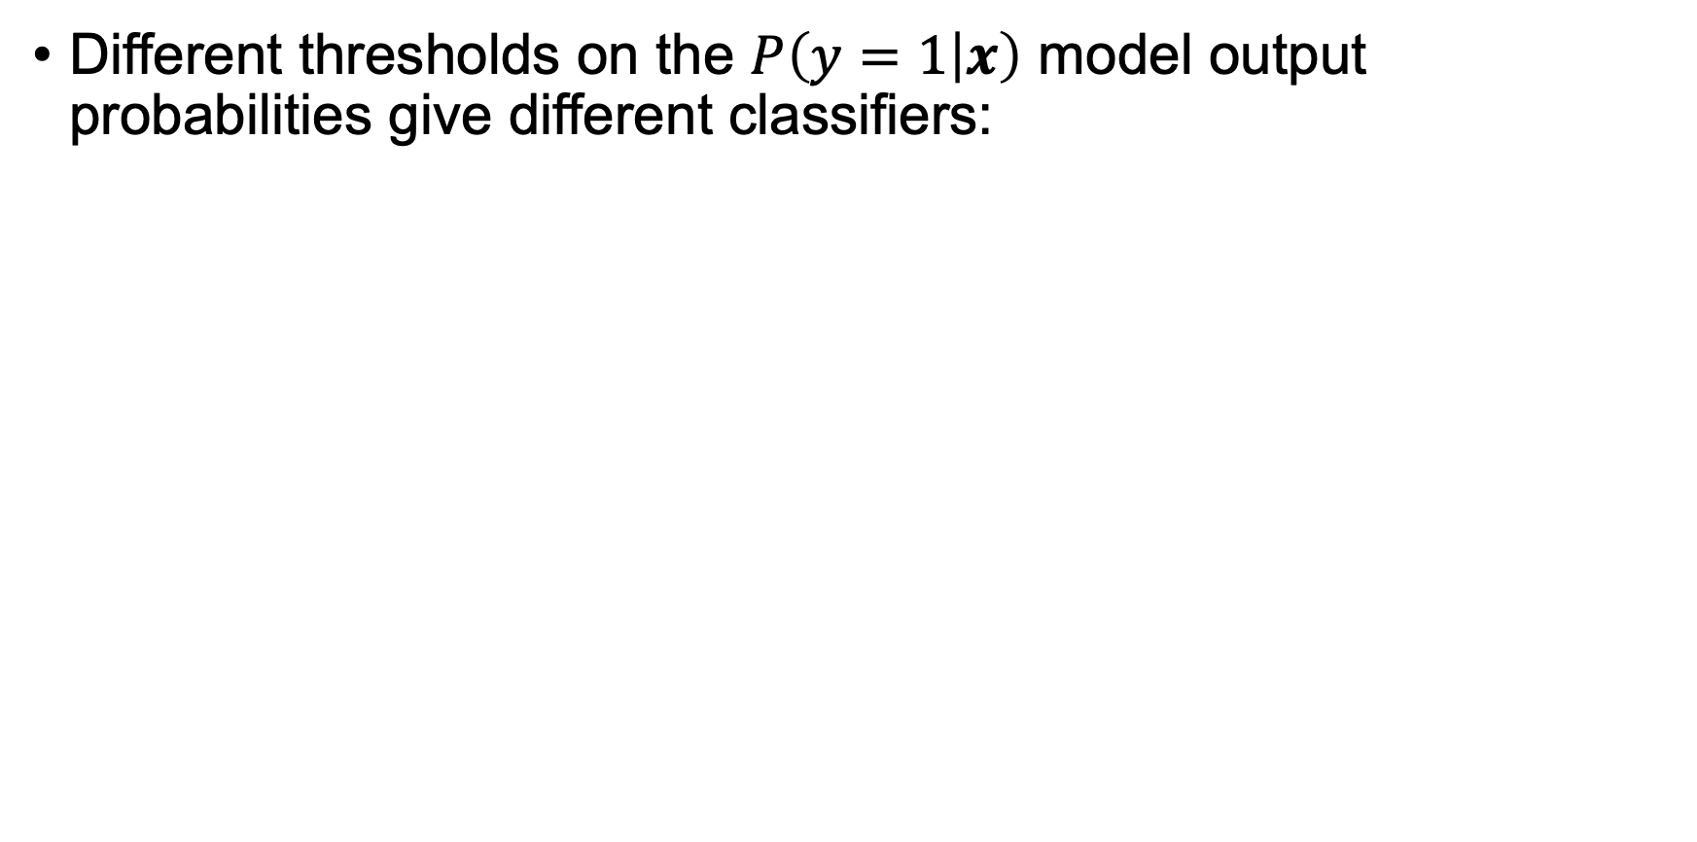

Classifier: $P\left(y=1 | x\right)$ and a threshold
Different thresholds on the $P\left(y=1 | x\right)$ model output probabilities give different classifiers:
Logistic example

Slide 18
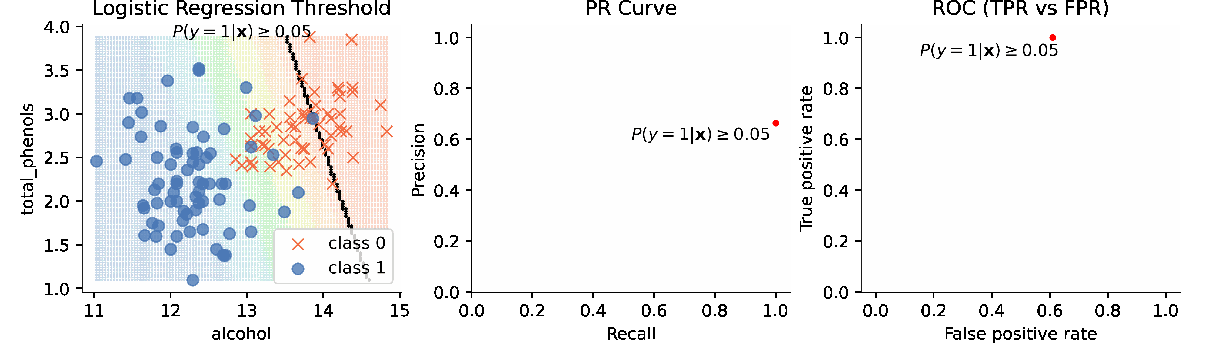
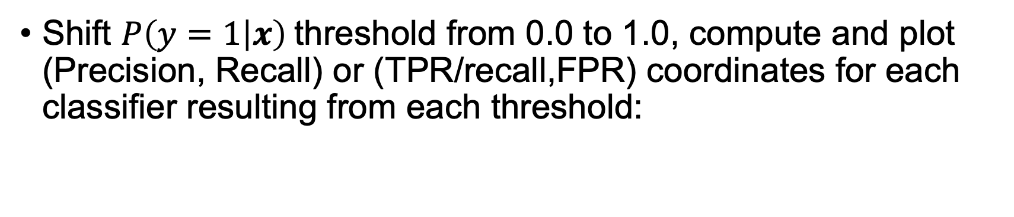
Animated ROC or PR curves
ROC == receiver operator curve
PR == precision-recall
Shift $P\left(y=1 | x\right)$threshold from 0.0 to 1.0, compute and plot (Precision, Recall) or (TPR/recall,FPR) coordinates for each classifier resulting from each threshold:
See https://github.com/parrt/msds621/blob/master/notebooks/assessment/PR-ROC-curves.ipynb

Slide 19
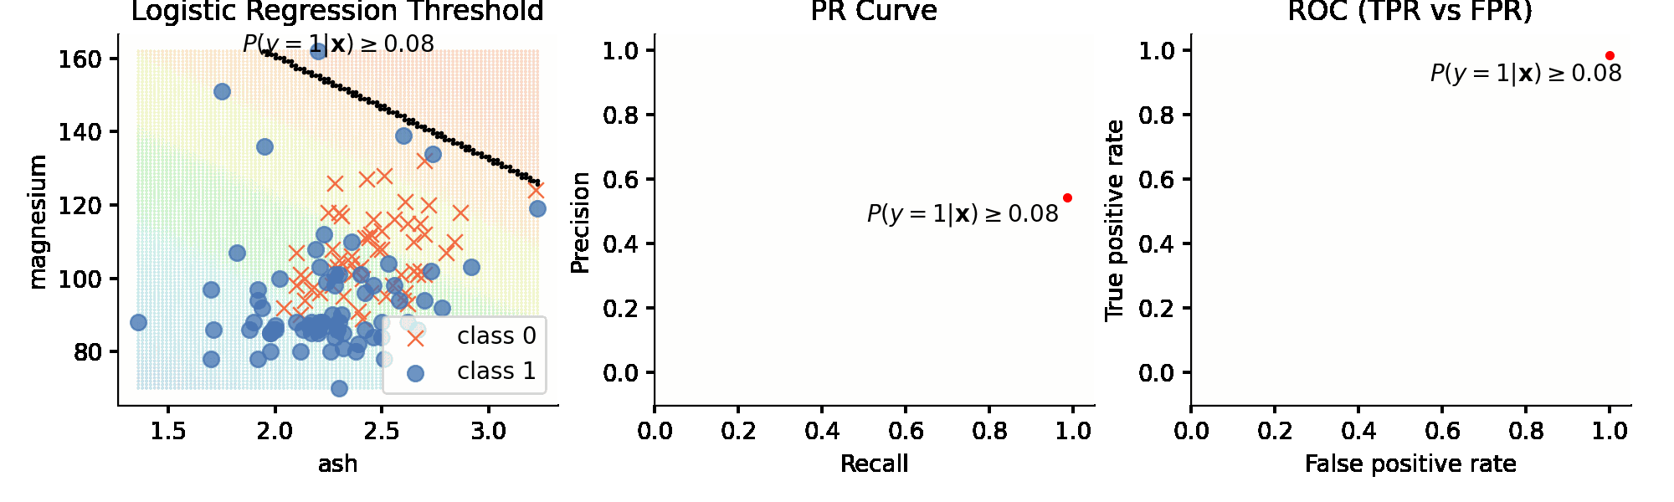
Compare with less predictive features
Notice how the less predictive features yield a partition with much more overlap
The curves for less well separated classes are much closer to the diagonal than for the good features

Slide 20
AUC precision-recall curve
Goal: Conjure up scalar from curve using AUC (area under the curve)
When distributions overlap exactly, moving threshold around gives -45 degree line, AUC=0.5
When distributions are completely separate, AUC=1
Any curve above 45° diagonal is better than overlapping distributions
See also https://developers.google.com/machine-learning/crash-course/classification/roc-and-auc

Slide 21
AUC ROC
Goal: Conjure up scalar from curve using AUC (area under the curve)
When distributions overlap exactly, moving threshold around gives 45 degree line, AUC=0.5
When distributions are reversed, AUC = 0
When distributions are completely separate, AUC=1
Any curve above 45° diagonal is better than overlapping distributions
See also https://developers.google.com/machine-learning/crash-course/classification/roc-and-auc

Slide 22
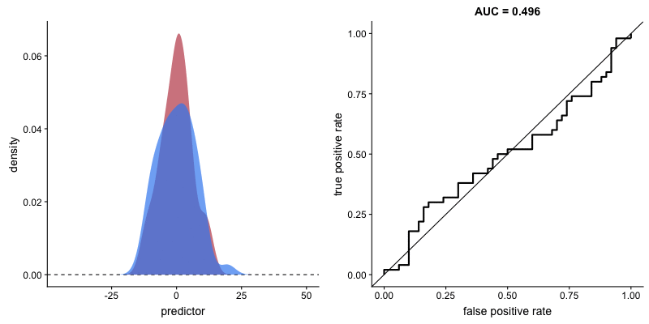
Why ROC and PR curves?
Curves indicate quality of specific model on a specific data set
More specifically, curves indicate how well/easily a model can separate class 0 from class 1 instances
Animation credits: https://github.com/dariyasydykova/open_projects/blob/master/ROC_animation/README.md

Slide 23
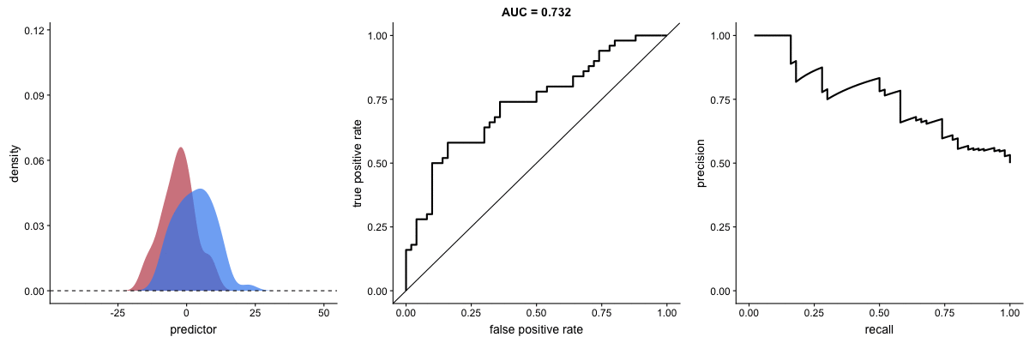
ROC vs Precision-Recall curve
As variance tightens, with more overlap, ROC AUC goes up whereas PR goes down; ROC doesn't have good behavior
Animation credits: https://github.com/dariyasydykova/open_projects/blob/master/ROC_animation/README.md

Slide 24
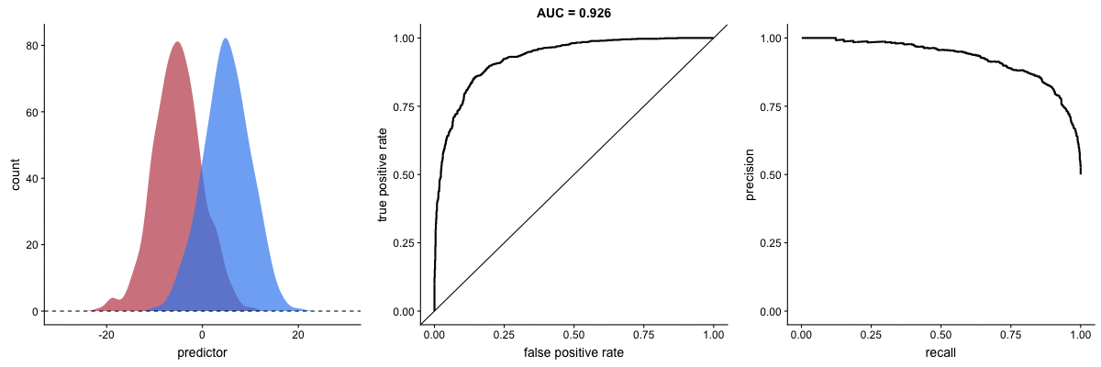
ROC vs PR curve: Imbalanced classes
Spam, fraud detection problems are imbalanced; can’t trust ROC!
For same threshold/mean of distribution, only PR curve changes!
In the end, I favor PR not ROC
Animation credits: https://github.com/dariyasydykova/open_projects/blob/master/ROC_animation/README.md

Slide 25
Upsampling minority class(es) in imbalanced data sets
Some models really benefit from this, such as linear models

Slide 26
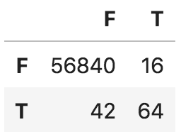
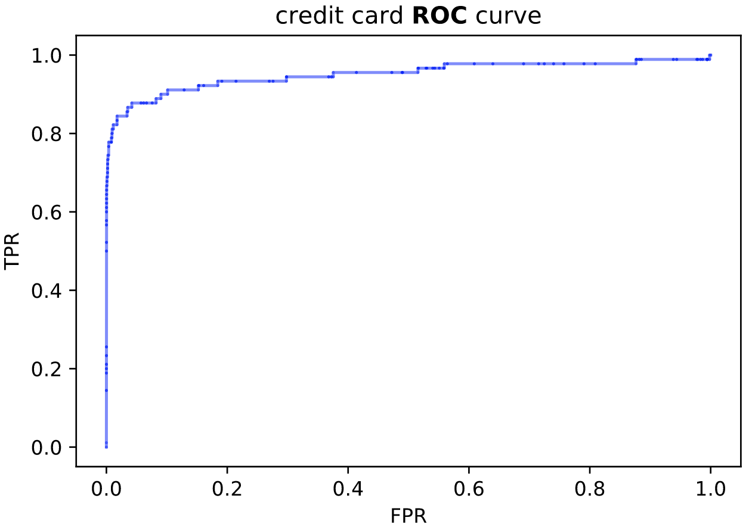
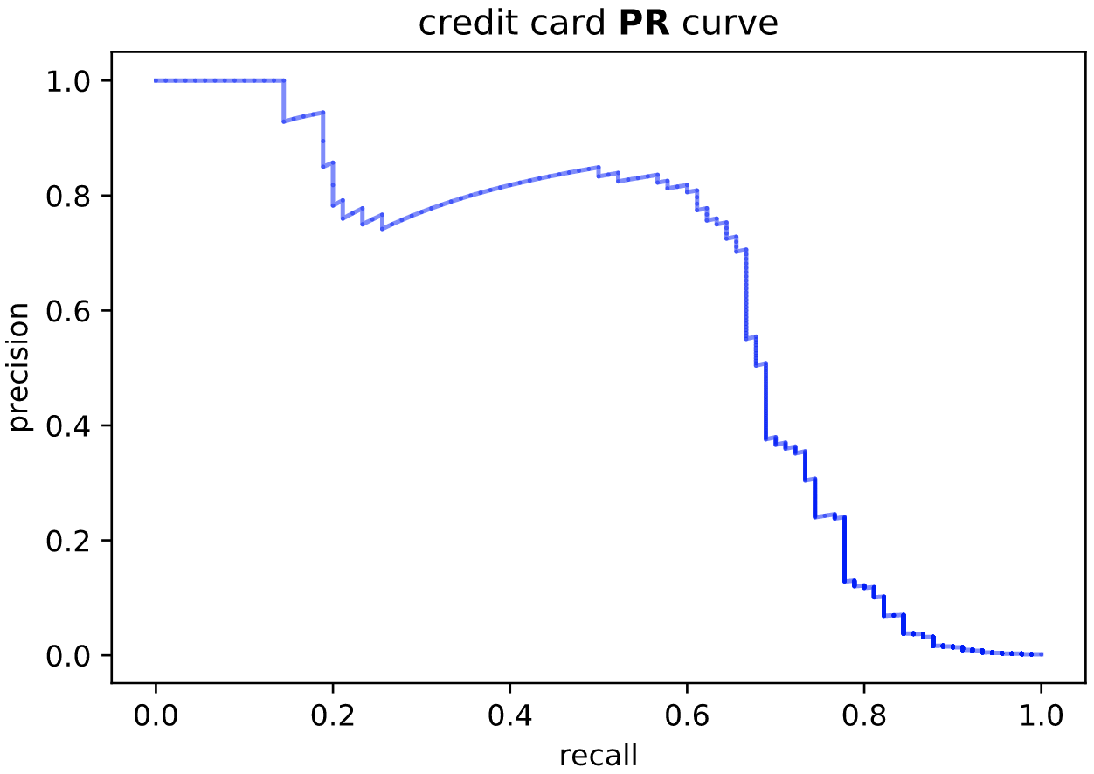
Imbalanced dataset: Kaggle credit card fraud
Credit card data: https://www.kaggle.com/mlg-ulb/creditcardfraud
Naïve use of train_test_split() @ 20%
predicted
Num anomalies 492/284807 = 0.17%
L2 Regularized LogisticRegression model
Accuracy 1.00, AUC ROC 0.93
F1 0.69, AUC PR 0.62
bad
actual
good
20% test set
Why is accuracy=1.0?
(That’s rounded up)
See https://github.com/parrt/msds621/blob/master/notebooks/assessment/imbalanced.ipynb

Slide 27
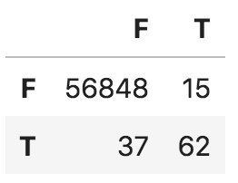
First: Proper split to ensure 20% minority class
Must split out test set before modeling but get 20% from each class at original ratio of class 1 / class 0 (particularly important for small n)
If num anomalies 492/284807 = 0.17%, then need:
TRAIN num fraud 393/227845 = 0.17%
TEST num fraud 99/56962 = 0.17%
Accuracy 1.00, AUC ROC 0.93
F1 0.70, AUC PR 0.65
df_good = df[df['Class']==0]
df_fraud = df[df['Class']==1]
df_train_good, df_test_good = train_test_split(df_good, test_size=0.20)
df_train_fraud, df_test_fraud = train_test_split(df_fraud, test_size=0.20)
df_train = pd.concat([df_train_good, df_train_fraud], axis=0)
df_test = pd.concat([df_test_good, df_test_fraud], axis=0)

Slide 28
Then: upsample minority in training set
Upsampled TRAIN num fraud 3930/231382 = 1.70%
TEST num fraud 99/56962 = 0.17%
df_good = df_train[df_train['Class']==0]
df_fraud = df_train[df_train['Class']==1]
df_fraud_balanced = df_fraud.sample(int(len(df_fraud)*10), replace=True)
df_train_upsampled = pd.concat([df_good, df_fraud_balanced], axis=0)
Do NOT upsamples before splitting out test set; you'll leak test data into training set! Tweet/paper on how this can cause data leakage:
https://arxiv.org/abs/2001.06296
https://twitter.com/Gillesvdwiele/status/1219194600994283520

Slide 29
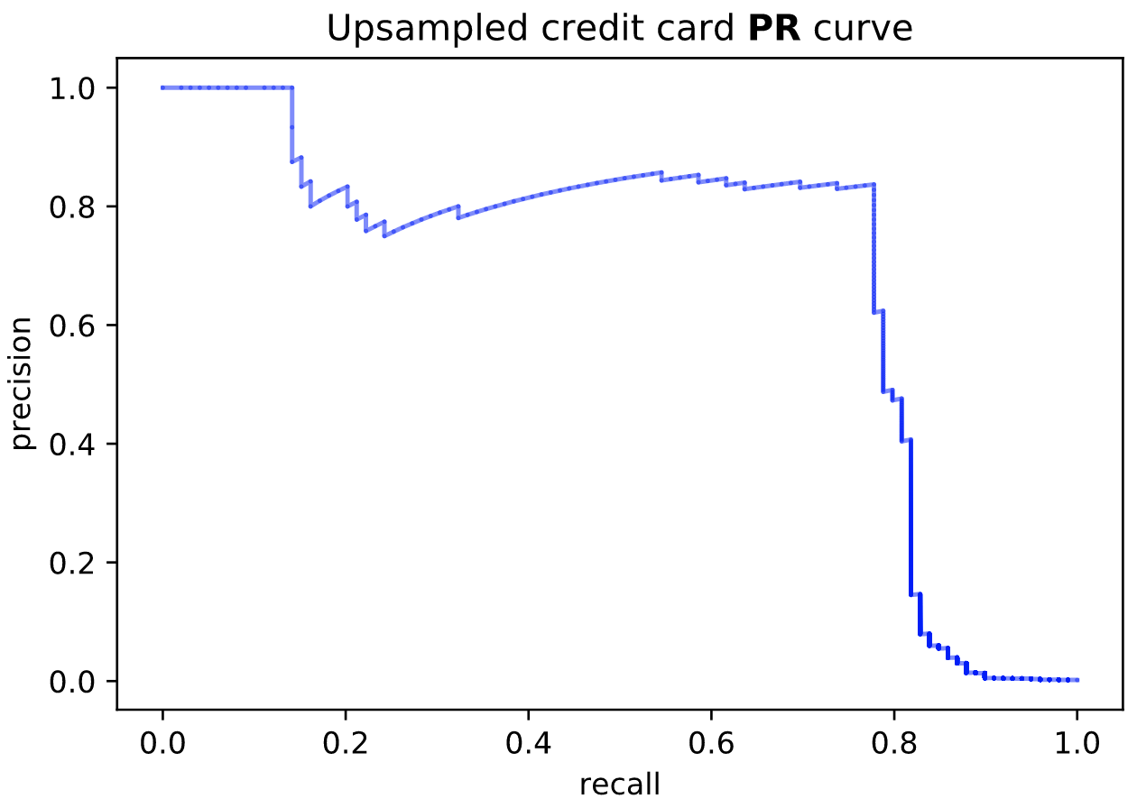
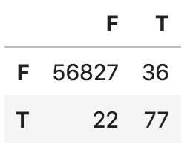
Upsampling fraud 10x in training data
No upsampling
We get improvement with upsampling for logistic regression, at least for this Kaggle credit card data set
F1 0.69, AUC PR 0.62
Accuracy 1.00, AUC ROC 0.95
F1 0.73, AUC PR 0.70
predicted
actual

Slide 30
L2 Logistic Regression summary
Naive split
F1 0.69, Accuracy 1.00
ROC 0.93, AUC PR 0.62
Proper split (just making sure train/test balance is right can help)
F1 0.70, Accuracy 1.00
AUC ROC 0.93, AUC PR 0.65
Upsample:
F1 0.73, Accuracy 1.00
AUC ROC 0.95, AUC PR 0.70
(Varies depending on actual test set held out)

Slide 31
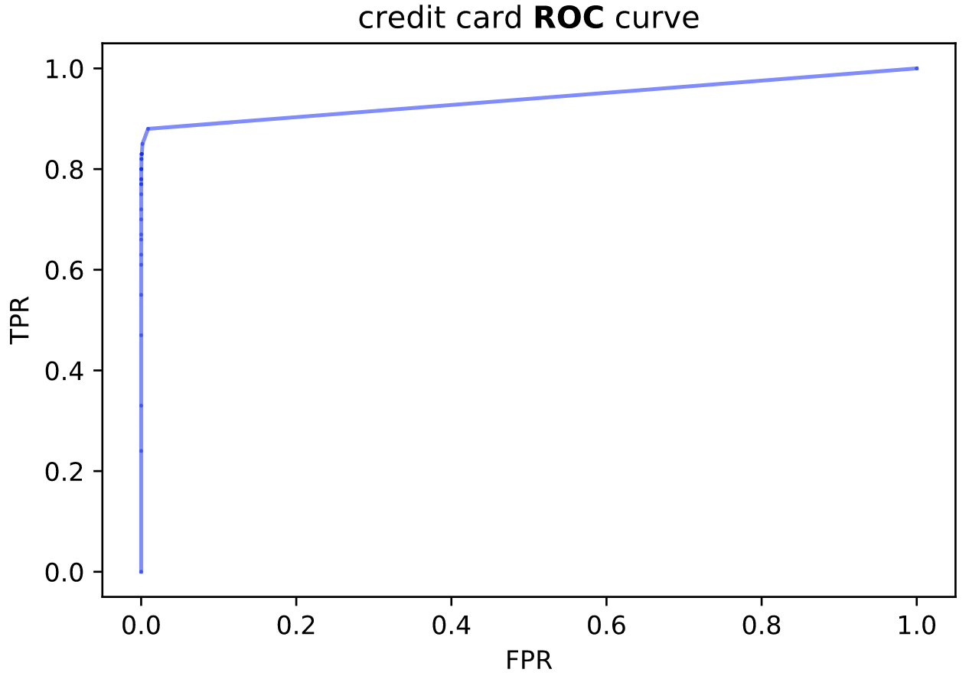
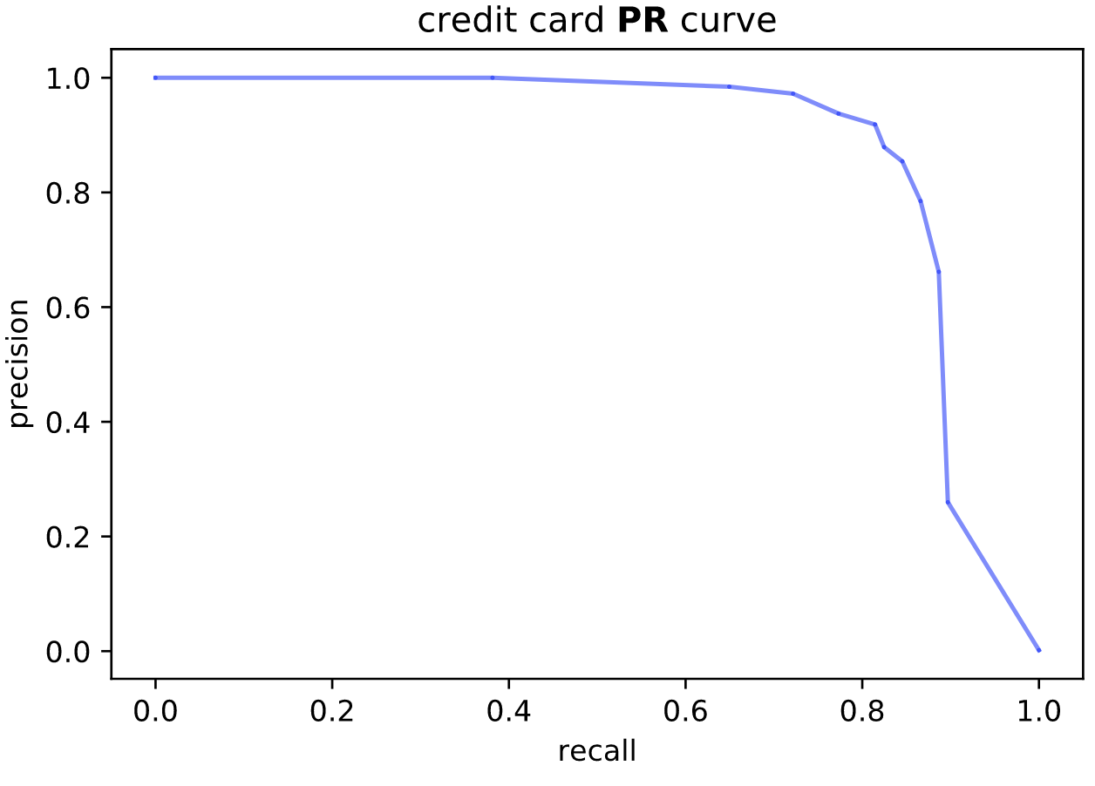
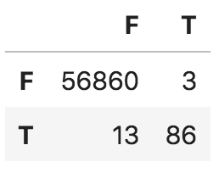
Credit card fraud with RF (10 trees)
RFs do better than logistic: RF better at isolating minority samples
Naïve: ROC 0.92, AUC PR 0.84
Balanced split: AUC ROC 0.97, AUC PR 0.93
10x upsampled training: AUC ROC 0.97, AUC PR 0.94 (doesn’t really help)
Naïve split
Naïve split

Slide 32
Classifier loss function

Slide 33
Penalizing inappropriate confidence
Terence’s cousin went to the doctor with suspected skin cancer
Doc was “100% positive mole was benign”
6 months later cousin loses most of her tricep / upper arm
Doc’s model was seriously flawed but not necessarily because of diagnosis
The biggest mistake was the certainty of the incorrect diagnosis, as it allowed the cancer to spread
Less certainty would’ve provided opportunities for more tests…
Same concept of model assessment applies to ML models

Slide 34
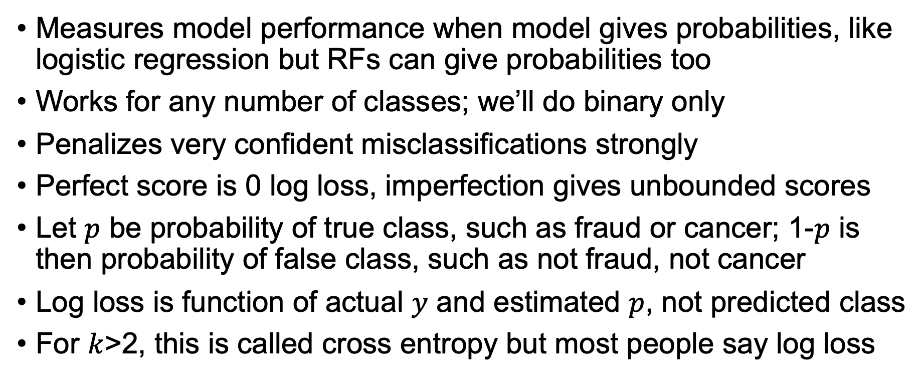
Log loss (is both metric and loss function)
Measures model performance when model gives probabilities, like logistic regression but RFs can give probabilities too
Works for any number of classes; we’ll do binary only
Penalizes very confident misclassifications strongly
Perfect score is 0 log loss, imperfection gives unbounded scores
Let $p$ be probability of true class, such as fraud or cancer; 1-$p$ is then probability of false class, such as not fraud, not cancer
Log loss is function of actual $y$ and estimated $p$, not predicted class
For $k$>2, this is called cross entropy but most people say log loss

Slide 35
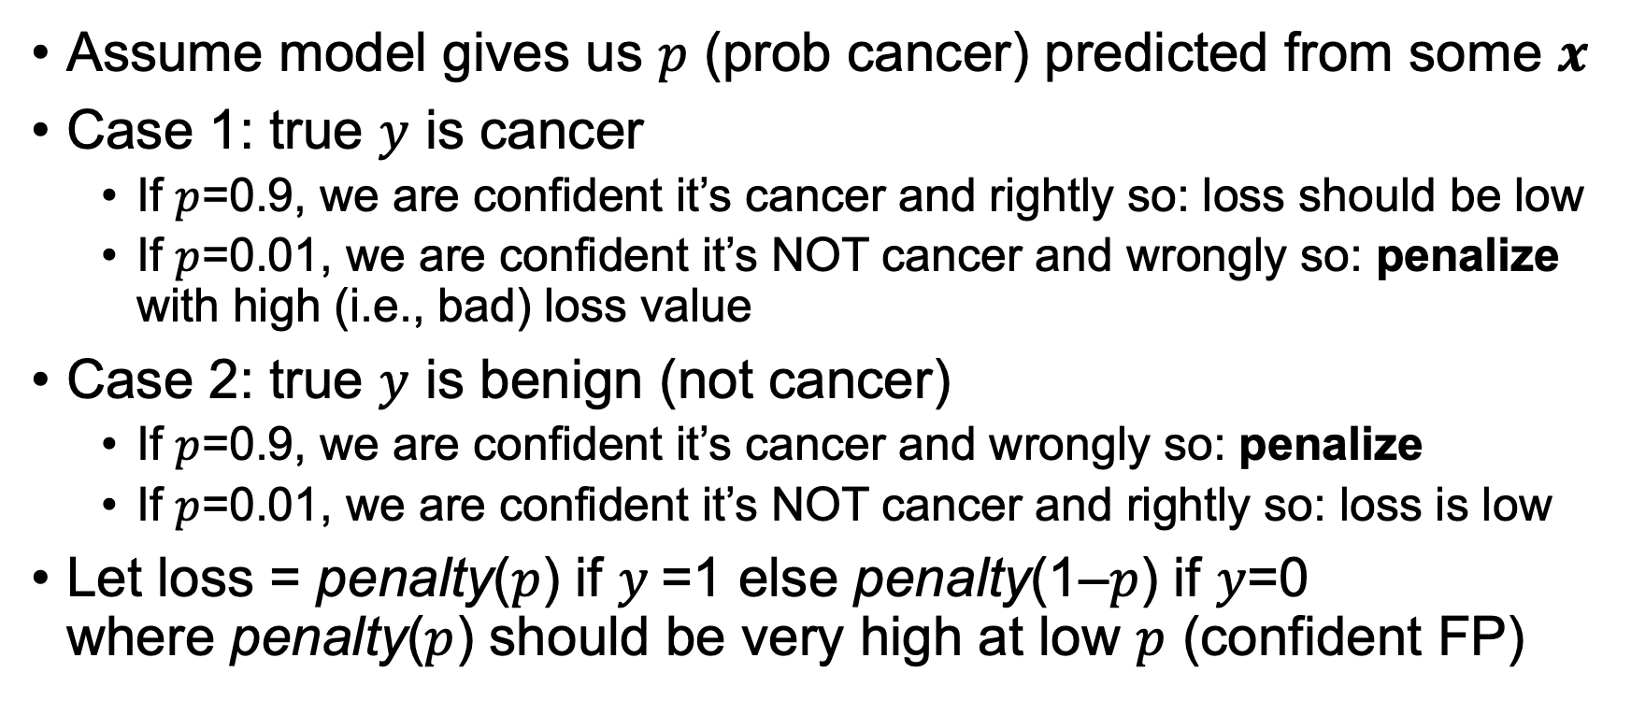
Log loss continued
Assume model gives us $p$ (prob cancer) predicted from some $x$
Case 1: true $y$ is cancer
If $p$=0.9, we are confident it’s cancer and rightly so: loss should be low
If $p$=0.01, we are confident it’s NOT cancer and wrongly so: penalize with high (i.e., bad) loss value
Case 2: true $y$ is benign (not cancer)
If $p$=0.9, we are confident it’s cancer and wrongly so: penalize
If $p$=0.01, we are confident it’s NOT cancer and rightly so: loss is low
Let loss = penalty($p$) if $y$=1 else penalty(1–$p$) if $y$=0 where penalty($p$) should be very high at low $p$ (confident FP)

Slide 36
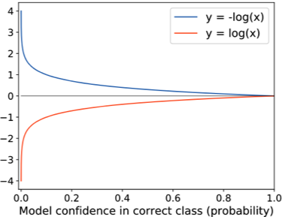
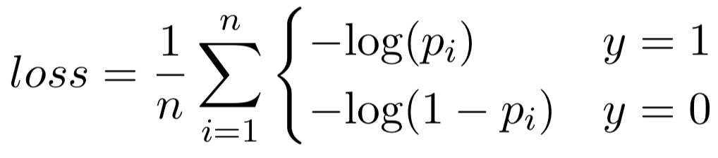
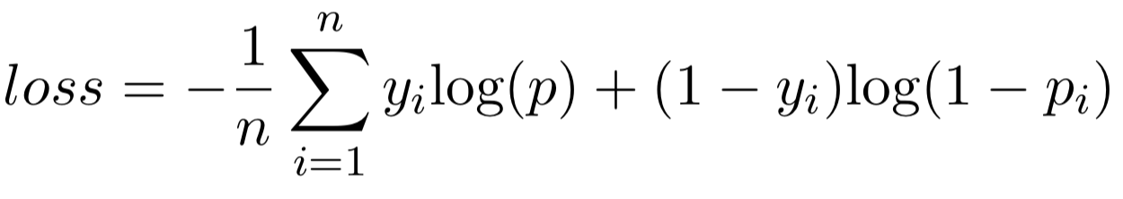
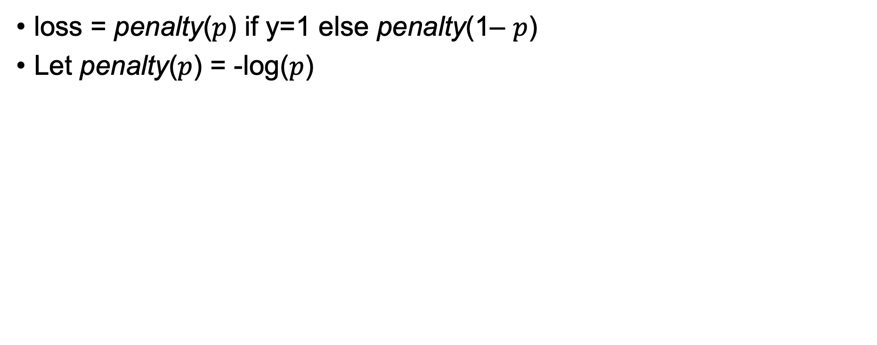
Log loss penalty
loss = penalty($p$) if y=1 else penalty(1– $p$)
Let penalty($p$) = -log($p$)
So log loss is average penalty where penalty is very high
for confidence in wrong answer

Slide 37
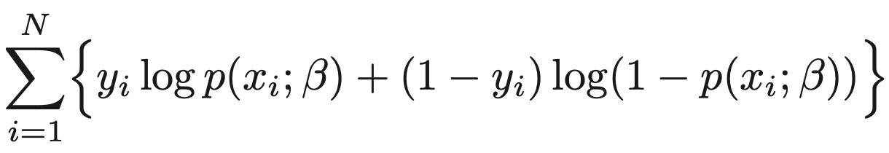
Log loss = negative log likelihood
For logistic regression, we minimize the max log likelihood:
Which is just what we derived:
ESLII page 120 eq 4.20

